Slide 1

TOPICS:
Economics of testing
How testing is conducted ?
Software testing-then(past)
Software testing-now(present)
Scope of software testing
Factors influencing the scope of testing
Risk based testing
Project & product risks
Need of independent testing
Activities in fundamental test process
Attributes of a good tester
Psychology of testing
Code of ethics for tester
Limitations of software testing

Slide 2
Economics of testing:
There is a definite economic impact of software testing. one economic impact is from the cost of defects. This is a very real and very tangible cost. Another economic impact is from the way we performing testing.it is possible to have very good motivations and testing goals while testing in a very inefficient way.

Slide 3
HOW TESTING IS CONDUCTED..?
Testing is based on external expectations internal behavior of the application is unknown. Testing is done on the basis of high-level database daiagrams and dataflow diagrams. Internal workings are fully known and the tester can design test data accordingly.
5 steps to perform:
Basic functionality testing
Code review
Static code analysis
Unit testing
Single-user perform testing

Slide 4
Software testing
Software testing-then(past):
Till the 70s,testing was seen asexercise to ensure that the software wworks as per the specified requirements.
It was then extended to find the errors,besides ensuring the proper functioning of the software.in the 80s,the testing activity eas also onsidered as a measurement of quality.

Slide 5
Software testing-now(present):
There are many different types of software tests, each with specific objectives and strategies.
acceptance testing: verifying whether the whole system works as intended.
Integration testing: ensuring that software components or functions operate together.
Unit testing: validating that each software uit performs as expected. A unit is the smallest testable component of an application.

Slide 6

Scope of software testing
The scope of software testing. Technically, software testing is an investigation conducted to provide stakeholders with information about the quality of a particular product or service under test. In other words, software testing is a process of verification and validation.

Slide 7
FACTORS INFLUENCIING THE SCOPE OF TESTING
Planning
Time
Size & complexity
Documentation
Skills
Team interaction
Methodology
Trends

Slide 8
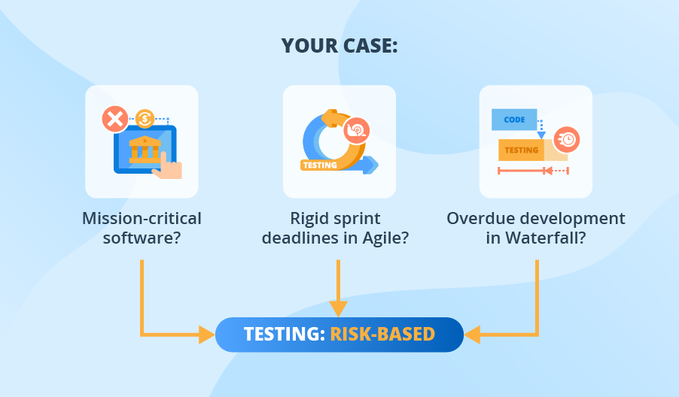
Risk based testing (RBT)
Risk based testing (RBT) is a type of software testing that functions as an organizational principle used to prioritize the tests of features and functions I software, based on the risk of failure, the function of their importance and likelihood or impact of failure.

Slide 9
PROJECT & PRODUCT RISKS
PROJECT RISK:
A project risk ia an uncertain event that may or may notoccur during a project. A project risk could have either a negative or a positive effect on progress towards project objectives.

Slide 10
PRODUCT RISK:
Product risk is the possibility that the system or software might fail to satisfy or fulfill some reasonable expectation of the customer, user, or stakeholder. some authors also called the product risks as quality risks as they are risks to the quality of the product.

Slide 11
Need of independent testing
An independent testing team gives an impartial, third-party view of the software leading to efficient and uninfluenced(assumption-free) testing that meets customer expectations. Independent testing finds more Defects compared to testing performed by the project team.

Slide 12
5 reasons why you should go for an independent software
Quality of testing
Less management effort
Access o th best testing talent
Total cost of ownership
Time to market

Slide 13
Activities in fundamental test process
Planning and control
Analysis and design
Implementation and execution
Evaluating exit criteria and reporting
Test closure activities

Slide 14
Attributes of a good tester
You understand priorities
You ask questions
You can create number of ideas
You can analyze data
You can report negative things in a positive way
You are good at reporting
You are flexible to support whenever it’s required

Slide 15
Psychology of testing
A psychological test is a standardized measure of a sample of a person’s. behaviour that is used to measure the individual differences that exist among people. A psychological test is an objective measure of an individual’s mental characteristics.

Slide 16
Code of ethics for tester
It sets forth values, principles, and standards that guide the testers to perform their tasks appropriately and helps them use the information they have in an ethical and appropriate manner.

Slide 17
Limitations of software testing
Exhaustive (total) testing is impossible in present scenario.
Time and budget constraints normally require very careful planning of the testing effort.
Compromise between thoroughness and budget.
Test results are used to make business decisions for release dates.

Slide 18
Thank you

